Slide 1
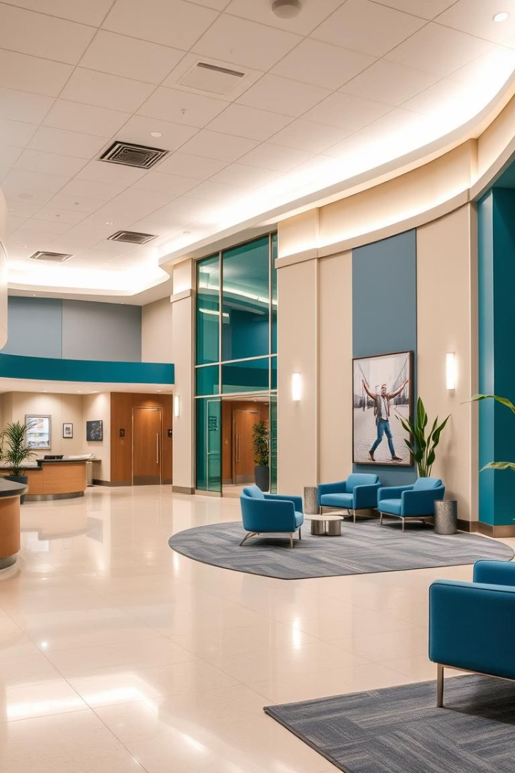

CPRM - Centralized Patient & Resource Management System
Key Features Overview
by 928 Gauresh

Slide 2

CPRM: Unifying Hospital Information Flow
Centralized Patient & Resource Management streamlines hospital operations.
Doctor: patient care
Pharmacist: medication flow
Technician: system oversight
General User: personalized access
Public Access: patient portal

Slide 3

Patient Management: Streamlined Care Coordination
Comprehensive Records
All patient data in one place
Appointment Scheduling
Easy booking and tracking
Medical History
Accessible treatment plans
Department Integration
Seamless cross-department flow

Slide 4

Drug Inventory: Real-Time Stock Management
24/7
95%
0
Real-time Tracking
Low Stock Alerts
Expiration Monitoring
Automatic reordering
Always know stock levels
Reduces waste

Slide 5
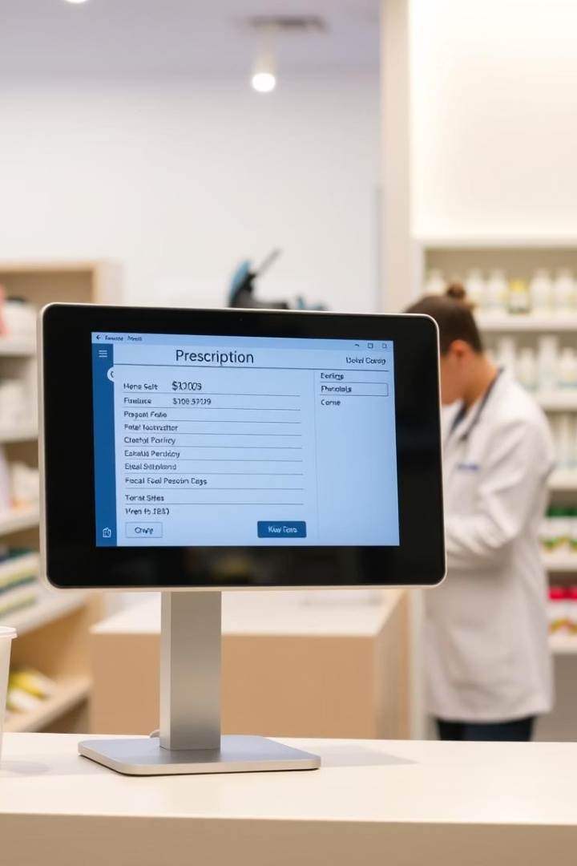




Prescription Orders: Efficient Medication Workflow
Digital Processing
Paperless prescriptions
Medication Tracking
From order to dispense
Doctor-Pharmacy Link
Clear communication
Patient Notifications
Pickup alerts

Slide 6
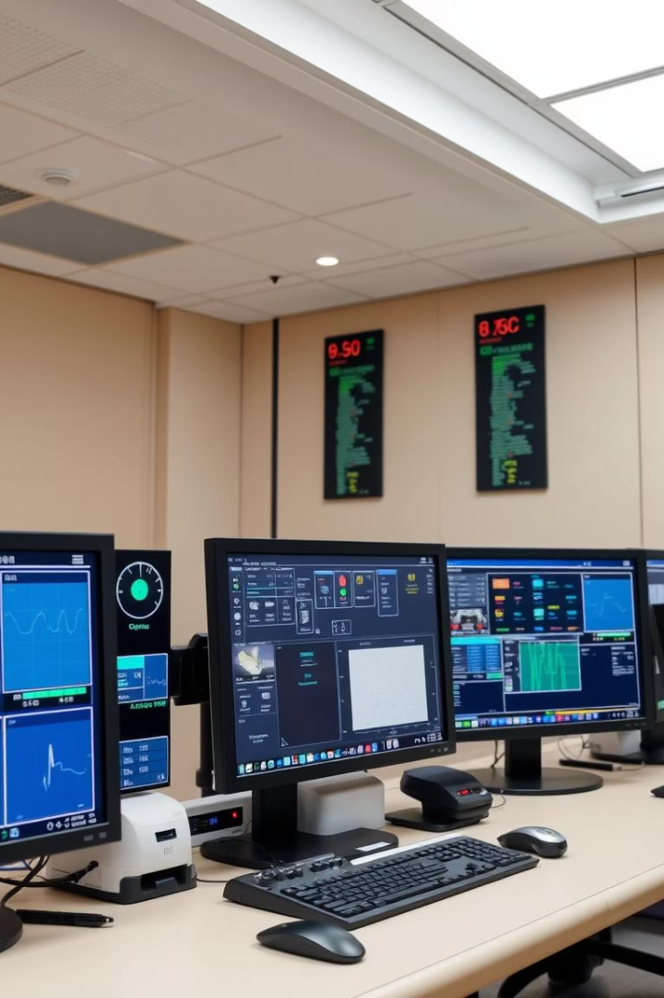




Display Maintenance: Centralized Screen Management
Monitor Displays
Schedule Content
Track Health
Control all 73 screens
Targeted information
Proactive issue detection
Remote Troubleshooting
Quick fixes

Slide 7
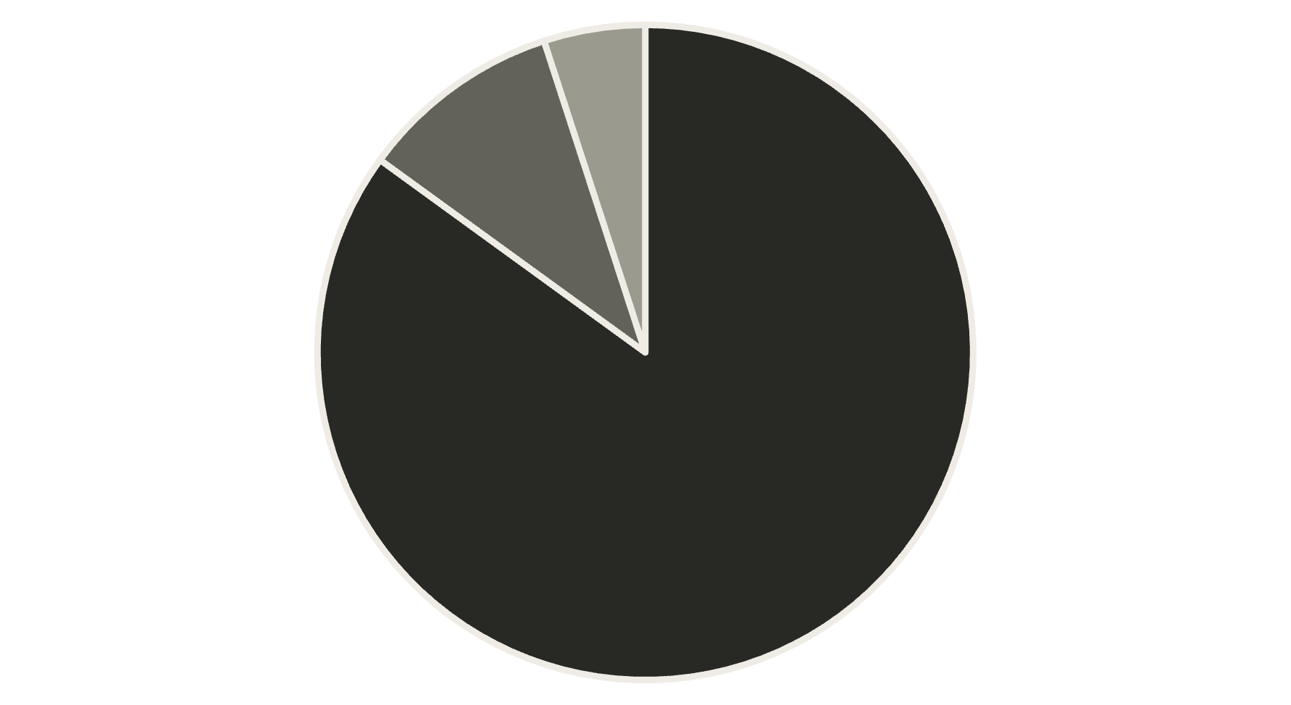
Technician Dashboard: System Health Overview
Operational
Monitoring
Maintenance
The dashboard provides a visual overview of system health, showing the percentage of systems that are fully operational, under monitoring, or undergoing maintenance. This allows technicians to quickly assess overall system performance and prioritize tasks effectively.

Slide 8
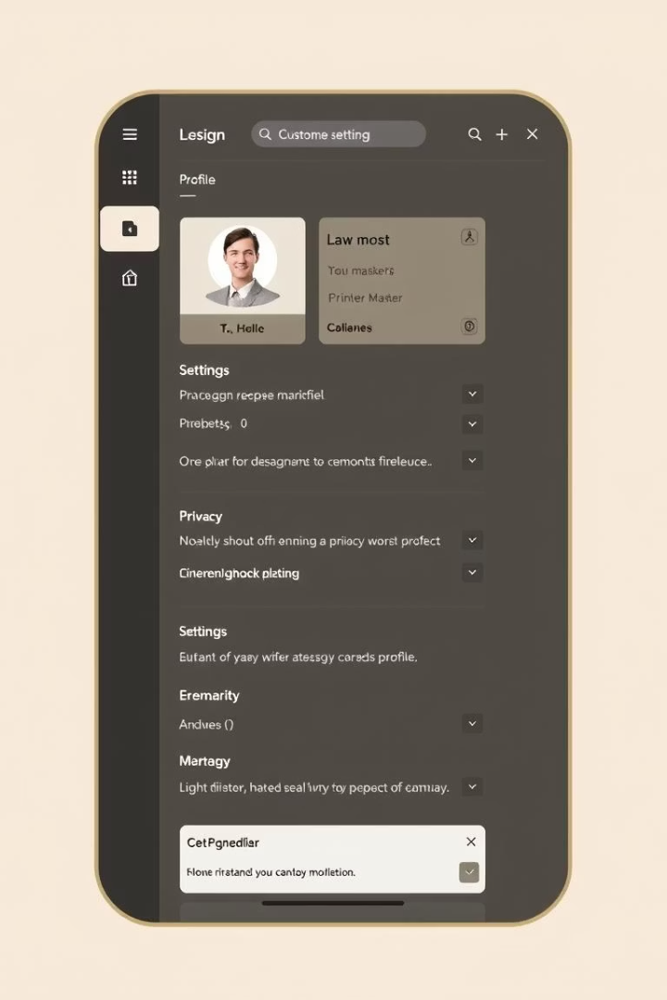




Profile Settings: Personalized User Experience
User Profile
Manage personal details
Security Settings
Password and access
Notification Preferences
Custom alerts
Interface Options
Personalize layout

